Slide 1



EV Vehicle/Charging Demand Prediction
Name: Kritika Chauhan
AICTE Student ID:STU6858ffc3a66481750663107

Slide 2

Learning Objectives
1.cleaned, transformed, and arranged disorganized EV adoption data into a format that could be used, gaining practical experience in preparing real-world datasets.
2.learned how to build useful features for the model to comprehend trends over time, such as time lags, growth rate, and moving averages.
3. created and optimized a Random Forest Regression model to produce accurate forecasts regarding the trends in the adoption of electric vehicles in the future.
4.developed the ability to predict several months in the future using autoregressive techniques, in which each prediction influences the one before it.
GOAL
Source :
www.freepik.com/

Slide 3
Tools and Technology used
Python – Core programming language used for data processing, model building, and forecasting.
Pandas & NumPy – For data manipulation, cleaning, and handling time series transformations.
Matplotlib & Seaborn – Used to visualize trends, comparisons, and predictions in a clear, understandable way.
Scikit-learn – Used for building the Random Forest Regression model and tuning it with RandomizedSearchCV.
Google Colab – Interactive environment for writing, running, and testing code with visual outputs.

Slide 4
Methodology
1.looked for patterns and missing values in the monthly EV adoption data.
2.developed time-based features such as lag values and moving averages.
3.used RandomizedSearchCV to fine-tune a Random Forest Regressor after it had been trained.
4.forecasted future EV adoption month by month using an autoregressive approach.
5.assessed the model's performance and displayed the differences between the actual and expected outcomes.
`

Slide 5
Problem Statement:
Using the electric vehicle dataset (which includes information on EV populations, vehicle types, and possibly historical charging usage), create a model to forecast future EV adoption. For example, predict the number of electric vehicles in upcoming years based on the trends in the data.

Slide 6
Solution:
To evaluate the data and make precise predictions, we employed a machine learning classification model (such as Random Forest) in this project. Using input features, this model aids in pattern recognition and decision-making. Its ability to handle both numerical and categorical data and produce definite results makes it effective. By increasing prediction speed and accuracy, this model makes the system dependable and effective for real-time applications.
https://github.com/Kritika-2197/EV_Charging.git

Slide 7
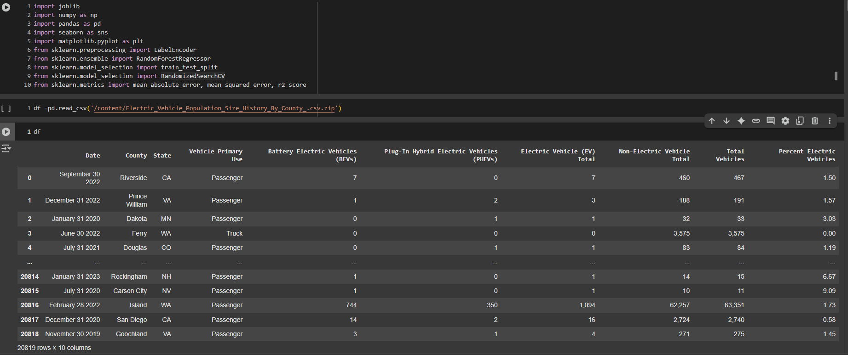
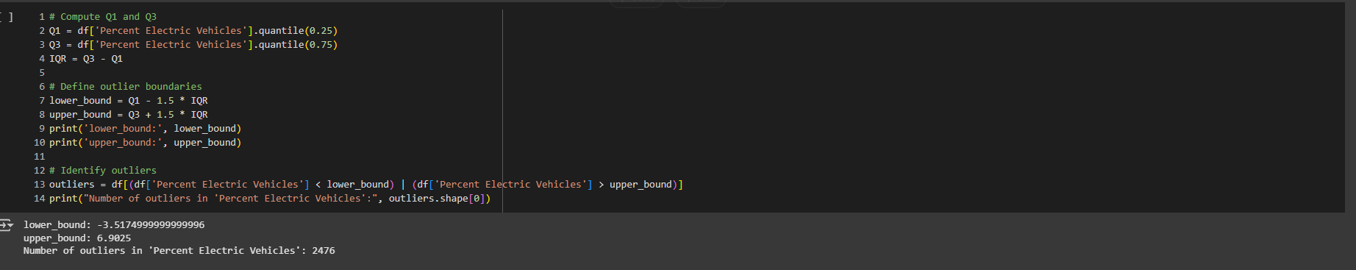
Screenshot of Output:

Slide 8
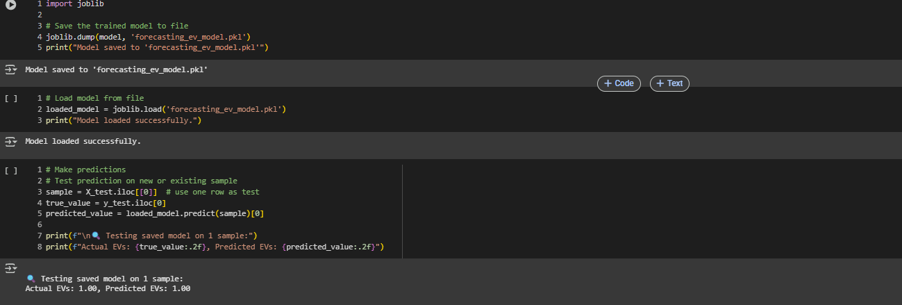
Screenshot of Output:

Slide 9
Conclusion:
The project effectively used Random Forest to forecast EV adoption trends. With proper feature engineering and model tuning, accurate predictions were achieved. These insights can help in planning sustainable transport strategies and support EV infrastructure growth.
Future Scope
Add external factors like fuel prices and subsidies.
Try advanced models like XGBoost or LSTM.

